Slide 1
Algorithm Analysis
Notes:
Objectives
To understand why algorithm analysis is important.
To be able to use “Big-O” to describe execution time.
To understand the “Big-O” execution time of common operations on Python lists and dictionaries.
To understand how the implementation of Python data impacts algorithm analysis.
To understand how to benchmark simple Python programs.

Slide 2
Announcement
Change for IN711 - Advanced Algorithms: Monday 15:00-17:00 class has been rescheduled to Tuesdays at 10:00-12:00 in D202, starting from Tuesday 28 July.

Slide 3

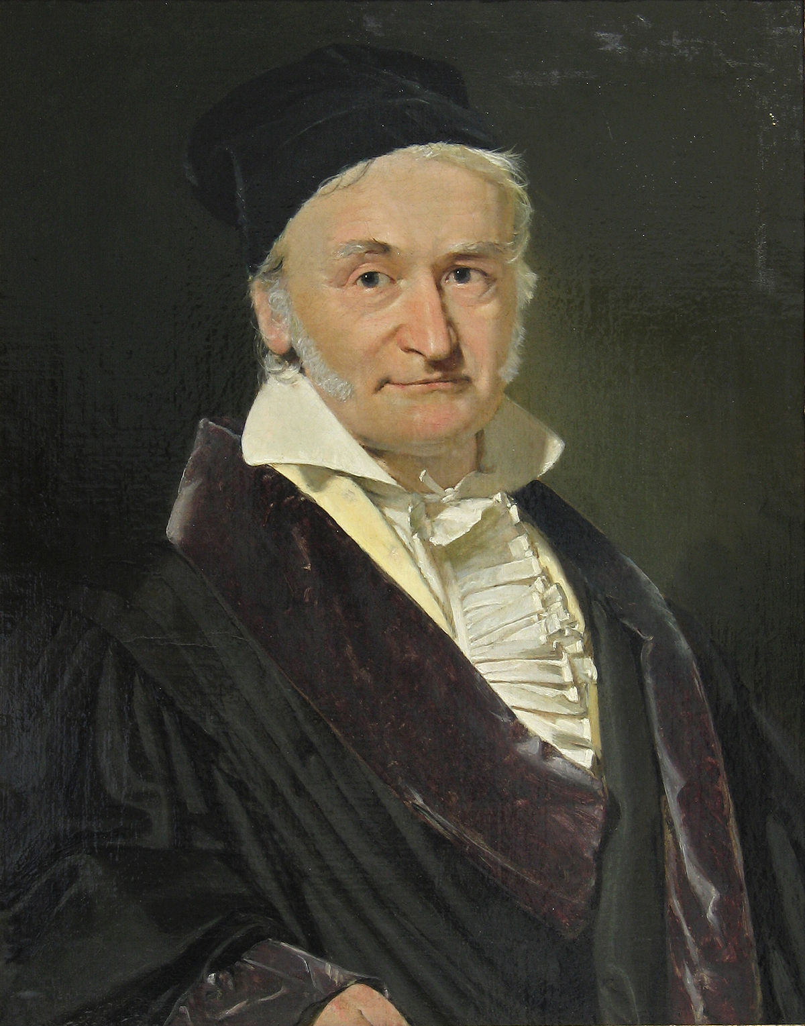
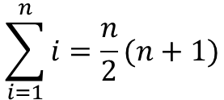
What algorithm is better?
When two algorithms solve the same problem but look different, is one algorithm better than the other?
Problem: computing the sum of the first n integers
[1,2,3,4,…,98,99,100]
def sumOfN(n):
theSum = 0
for i in range(1,n+1):
theSum = theSum + i
return theSum
$$\sum_{i=1}^{n}{i=\frac{n}{2}(n+1)}$$
def sumOfN3(n):
return (n*(n+1))/2
Notes:
There is an important difference between a program and the underlying algorithm that the program is representing.
An algorithm is a generic, step-by-step list of instructions for solving a problem.
It is a method for solving any instance of the problem such that given a particular input, the algorithm produces the desired result.
A program, on the other hand, is an algorithm that has been encoded into some programming language.
There may be many programs for the same algorithm, depending on the programmer and the programming language being used.

Slide 4
What Is Algorithm Analysis?
Algorithm analysis is concerned with comparing algorithms based upon the amount of computing resources that each algorithm uses.
We want to be able to consider two algorithms and say that one is better than the other because it is more efficient in its use of those resources or perhaps because it simply uses fewer.

Slide 5


What do we mean by computing resources?
Two main types of computer resources:
Computational time: execution time or running time of an algorithm
Computational memory: amount of space or memory an algorithm requires to solve a problem

Slide 6

The problem with measuring execution time
The same algorithm will show different execution times in different types of hardware
There is a better way of characterizing algorithm performance that is independent of hardware
def sumOfN(n):
theSum = 0
for i in range(1,n+1):
theSum = theSum + i
return theSum
def sumOfN3(n):
return (n*(n+1))/2

Slide 7
Runtime analysis
When trying to characterize an algorithm’s efficiency in terms of execution time, independent of any particular program or computer, it is important to quantify the number of operations or steps that the algorithm will require.
If each of these steps is considered to be a basic unit of computation, then the execution time for an algorithm can be expressed as the number of steps required to solve the problem.
Deciding on an appropriate basic unit of computation can be a complicated problem and will depend on how the algorithm is implemented.

Slide 8
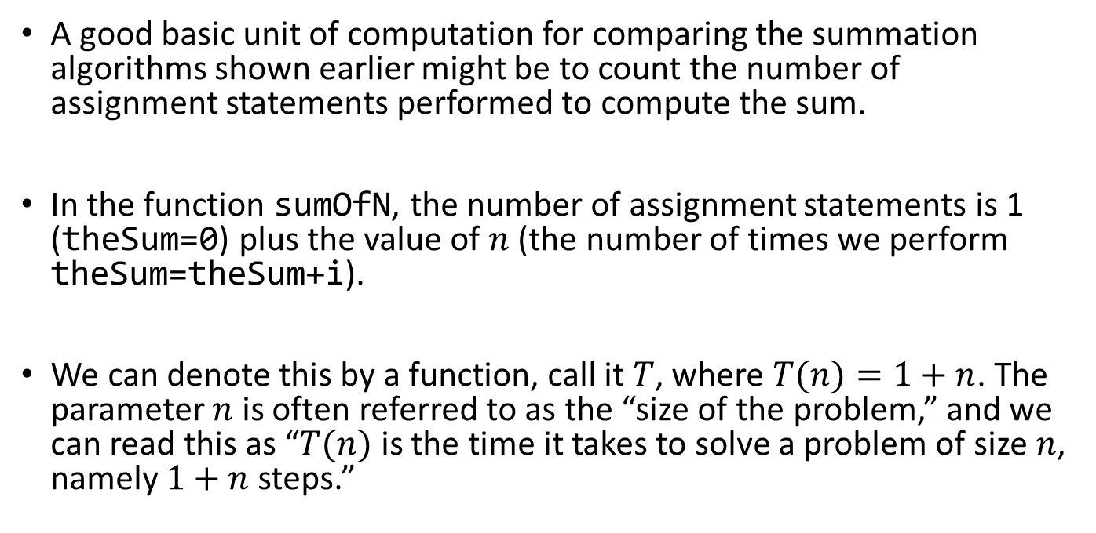
Runtime analysis
A good basic unit of computation for comparing the summation algorithms shown earlier might be to count the number of assignment statements performed to compute the sum.
In the function sumOfN, the number of assignment statements is 1 (theSum=0) plus the value of $n$ (the number of times we perform theSum=theSum+i).
We can denote this by a function, call it $T$, where $T(n)=1+n$. The parameter $n$ is often referred to as the “size of the problem,” and we can read this as “$T(n)$ is the time it takes to solve a problem of size $n$, namely $1+n$steps.”
def sumOfN(n):
theSum = 0
for i in range(1,n+1):
theSum = theSum + i
return theSum

Slide 9
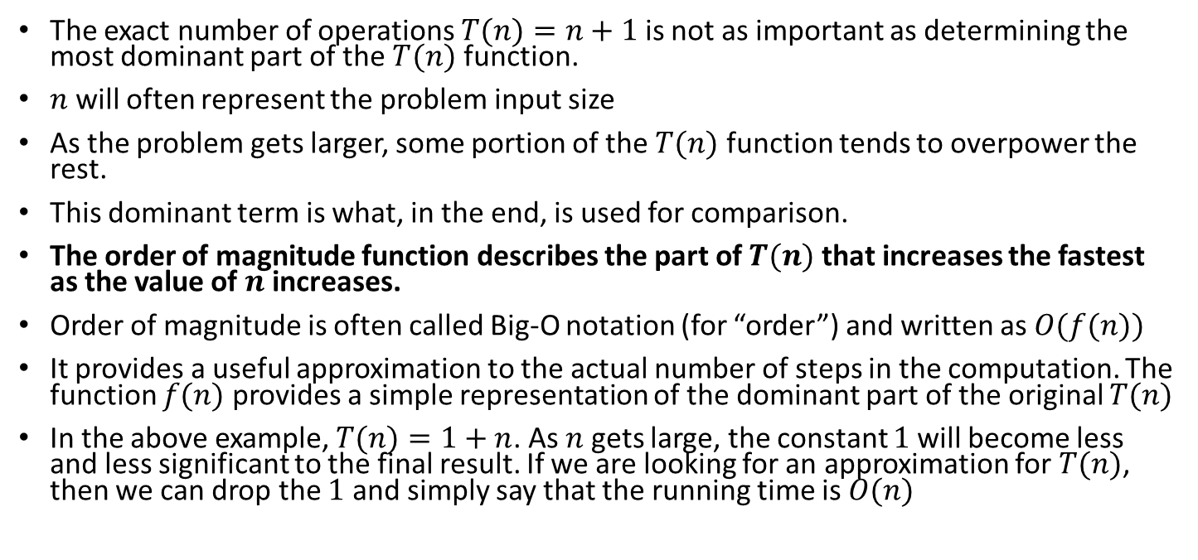
Order of magnitude function - Big-O Notation
The exact number of operations $T(n)=n+1$is not as important as determining the most dominant part of the $T(n)$ function.
$n$ will often represent the problem input size
As the problem gets larger, some portion of the $T(n)$ function tends to overpower the rest.
This dominant term is what, in the end, is used for comparison.
The order of magnitude function describes the part of $T(n)$ that increases the fastest as the value of $n$increases.
Order of magnitude is often called Big-O notation (for “order”) and written as $O(f(n))$
It provides a useful approximation to the actual number of steps in the computation. The function $f(n)$ provides a simple representation of the dominant part of the original $T(n)$
In the above example, $T(n)=1+n$. As $n$ gets large, the constant $1$will become less and less significant to the final result. If we are looking for an approximation for $T(n)$, then we can drop the $1$ and simply say that the running time is $O(n)$
def sumOfN(n):
theSum = 0
for i in range(1,n+1):
theSum = theSum + i
return theSum

Slide 10
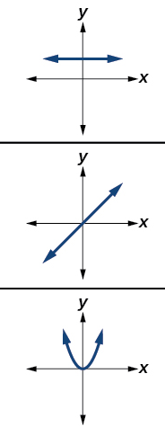

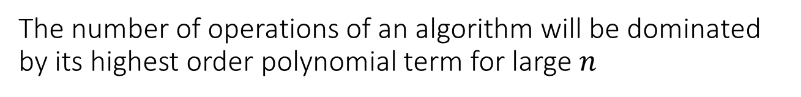
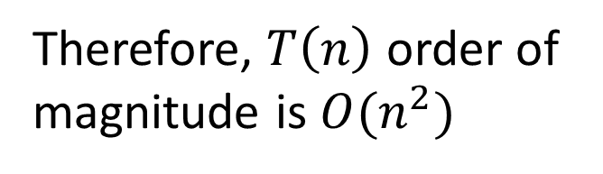
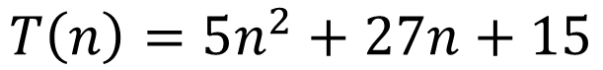
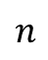
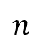
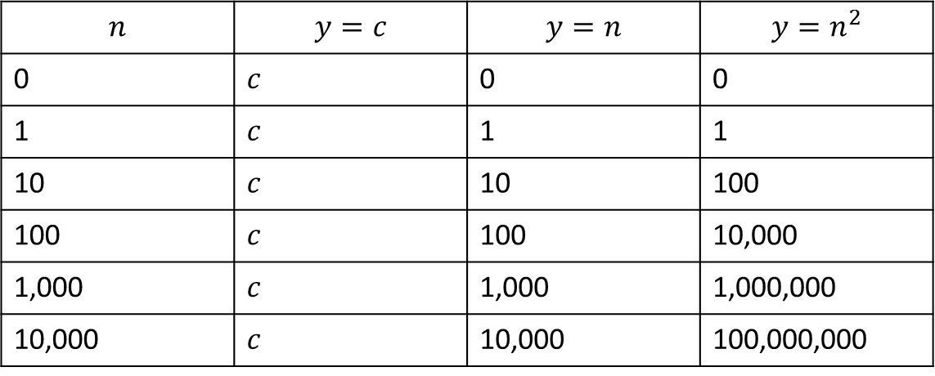
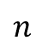
The number of operations of an algorithm will be dominated by its highest order polynomial term for large $n$
$$n$$
$$n$$
$$n$$
$$n$$ | $$y=c$$ | $$y=n$$ | $$y=n^{2}$$
0 | $$c$$ | 0 | 0
1 | $$c$$ | 1 | 1
10 | $$c$$ | 10 | 100
100 | $$c$$ | 100 | 10,000
1,000 | $$c$$ | 1,000 | 1,000,000
10,000 | $$c$$ | 10,000 | 100,000,000
$$T\left(n\right)=5n^{2}+27n+15$$
Therefore, $T\left(n\right)$ order of magnitude is $O(n^{2})$
This term dominates for large $n$

Slide 11
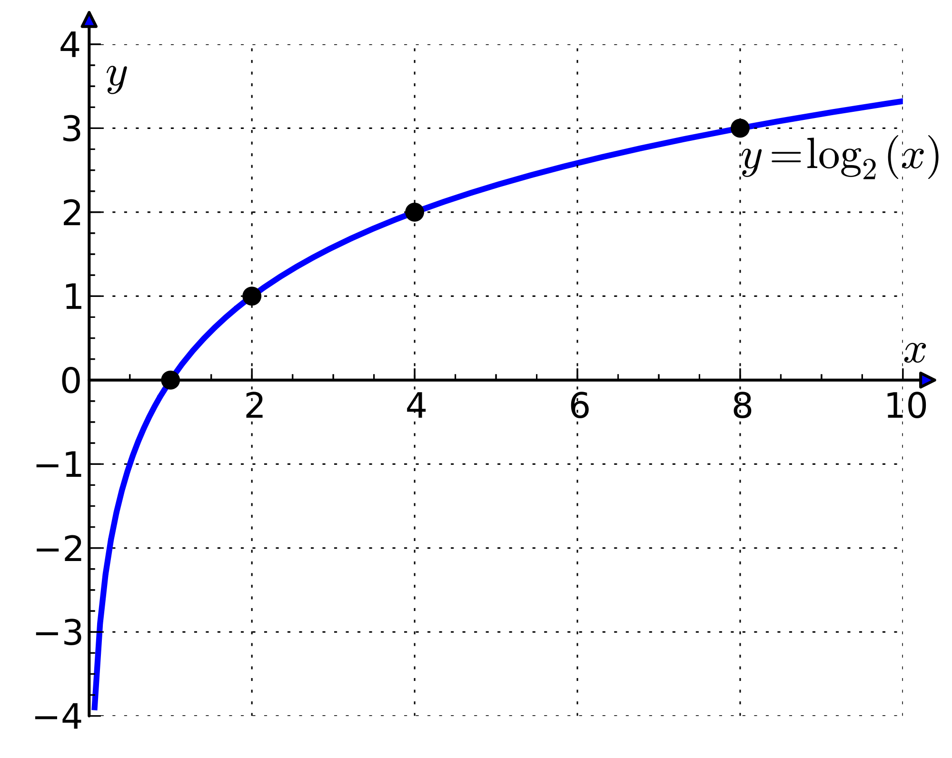
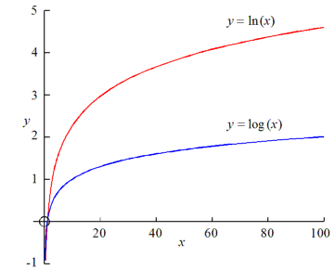
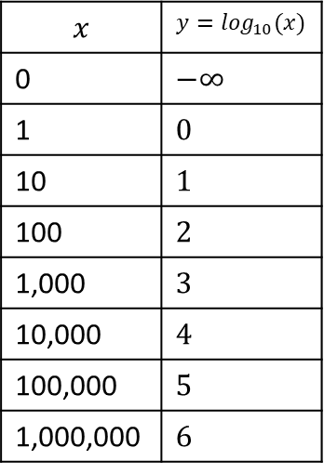
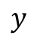
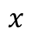
The logarithmic function
$$x$$ | $$y=\log_{10}⁡(x)$$
0 | $$−∞$$
1 | $$0$$
10 | $$1$$
100 | $$2$$
1,000 | $$3$$
10,000 | $$4$$
100,000 | $$5$$
1,000,000 | $$6$$
The logarithmic function markedly dampens the impact of the input magnitude on the output of the function
$$y$$
$$x$$

Slide 12
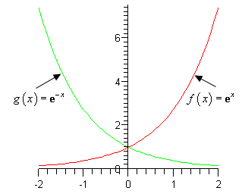
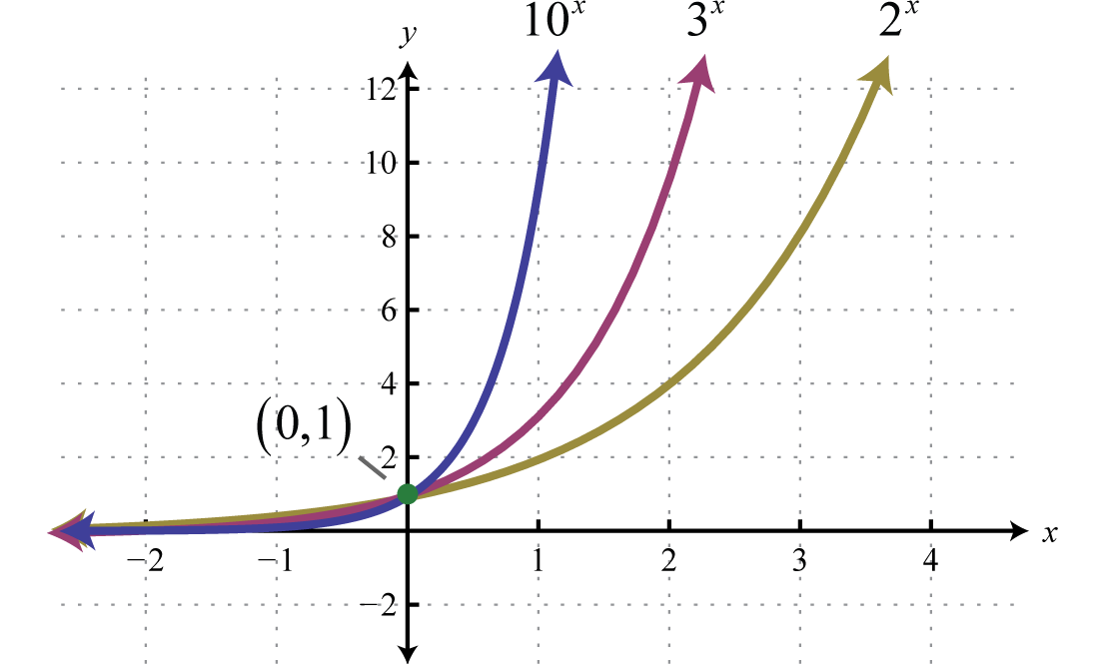
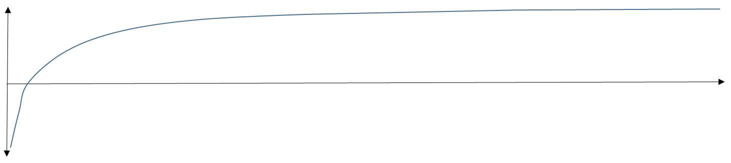
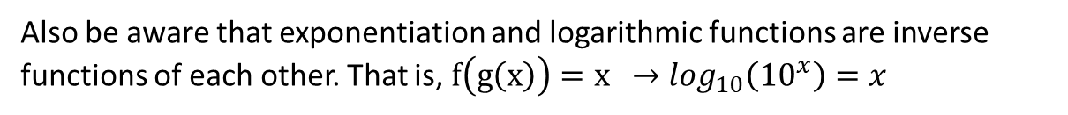
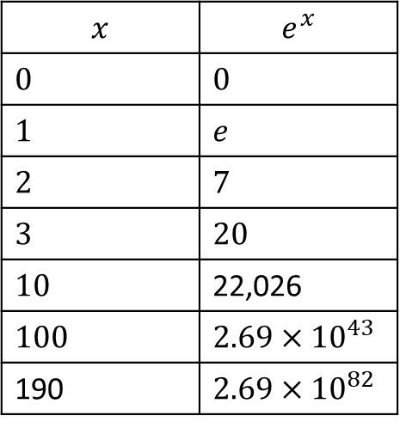
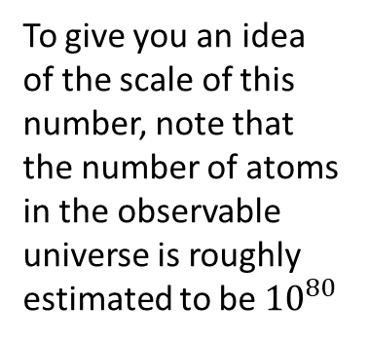
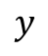
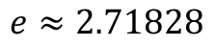
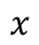
The exponential function
$$y$$
$$e≈2.71828$$
$$x$$ | $$e^{x}$$
$$0$$ | $$0$$
$$1$$ | $$e$$
$$2$$ | $$7$$
$$3$$ | $$20$$
$$10$$ | 22,026
$$100$$ | $$2.69×{10}^{43}$$
190 | $$2.69×{10}^{82}$$
To give you an idea of the scale of this number, note that the number of atoms in the observable universe is roughly estimated to be ${10}^{80}$
Also be aware that exponentiation and logarithmic functions are inverse functions of each other. That is, $f\left(g\left(x\right)\right)=x$ $→\log_{10}\left({10}^{x}\right)=x$
$$x$$

Slide 13
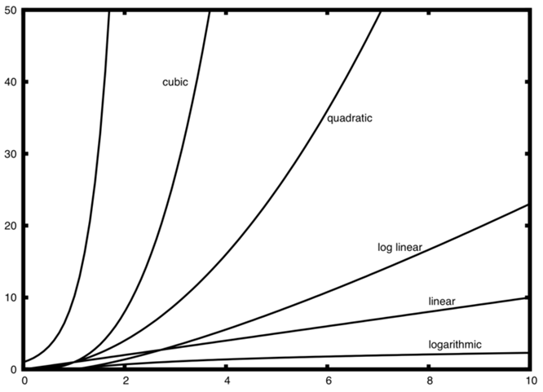
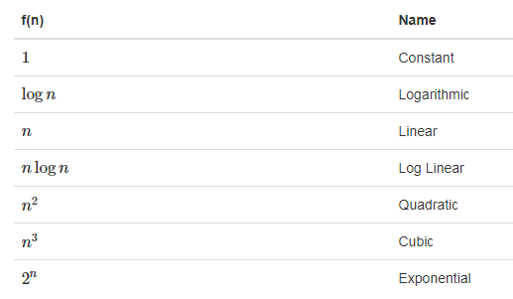
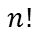
Common order of growth (aka magnitude) functions
factorial
exponential
$$n!$$
Factorial

Slide 14
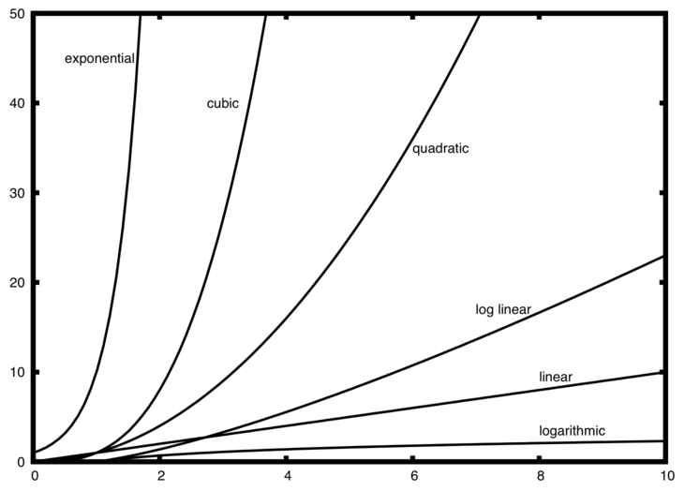
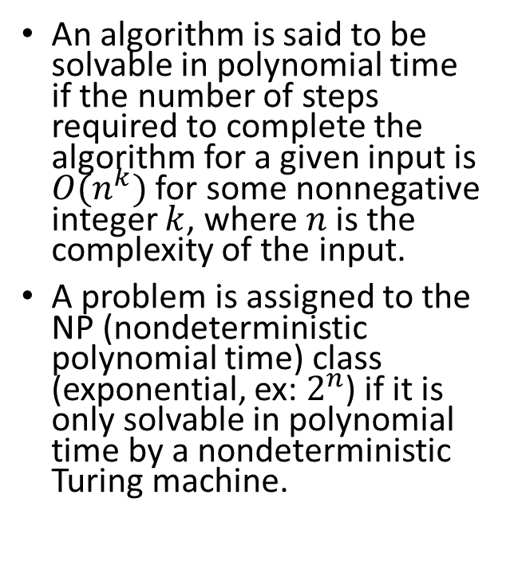
Revisiting P and NP problems
An algorithm is said to be solvable in polynomial time if the number of steps required to complete the algorithm for a given input is $O(n^{k})$ for some nonnegative integer $k$, where $n$is the complexity of the input.
A problem is assigned to the NP (nondeterministic polynomial time) class (exponential, ex: $2^{n}$) if it is only solvable in polynomial time by a nondeterministic Turing machine.
Notes:
Most familiar mathematical operations such as addition, subtraction, multiplication, and division, as well as computing square roots, powers, and logarithms, can be performed in polynomial time. Computing the digits of most interesting mathematical constants, including e and $π$, can also be done in polynomial time.

Slide 15
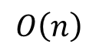
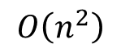
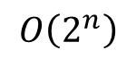
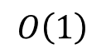
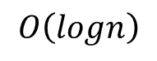
How does time complexity relate to code?
def blabla(n):
if n[len(n)/2]== v:
return n
$$O\left(1\right)$$
def blabla(n):
while n > 1:
n = n/2
if m[n] == v:
return True
elif m[n]<v:
m=blabla(m[0:n])
elif:
m=blabla(m[n:])
$$O\left(logn\right)$$
$$O\left(n\right)$$
for i in range(1,n):
if m[i,j] == v:
return True
for i in range(1,n):
for j in range(1,n):
if m[i,j] == v:
return True
$$O\left(n^{2}\right)$$
0
0
0
0
0
1
0
0
0
1
0
0
1
1
0
0
for i₁ in range(1,2):
for j₂ in range(1,2):
… n times
for z_{n} in range(1,2
0
0
0
1
0
1
0
1
0
1
0
1
1
1
0
1
$$O\left(2^{n}\right)$$
0
0
1
0
0
1
1
0
0
1
1
0
1
1
1
0
0
0
1
1
0
1
1
1
0
1
1
1
1
1
1
1

Slide 16
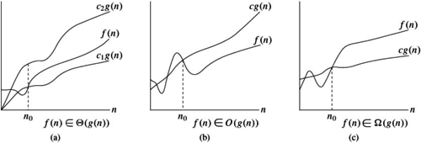
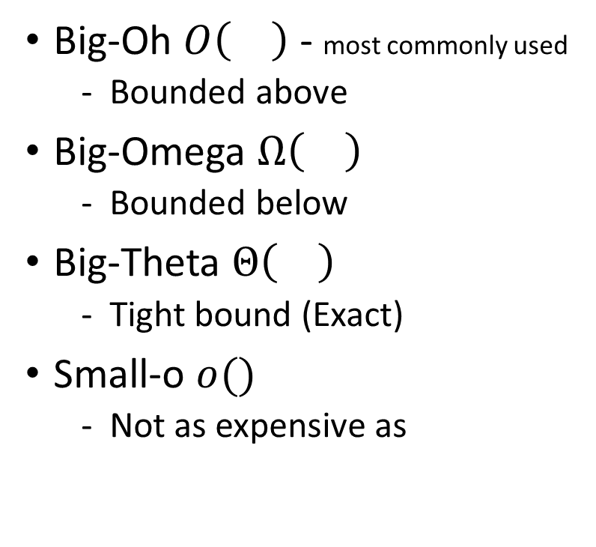
Additional tools for running time analysis
Big-Oh $O\left(\right)$ - most commonly used
Bounded above
Big-Omega $Ω\left(\right)$
Bounded below
Big-Theta $Θ\left(\right)$
Tight bound (Exact)
Small-o $o()$
Not as expensive as

Slide 17

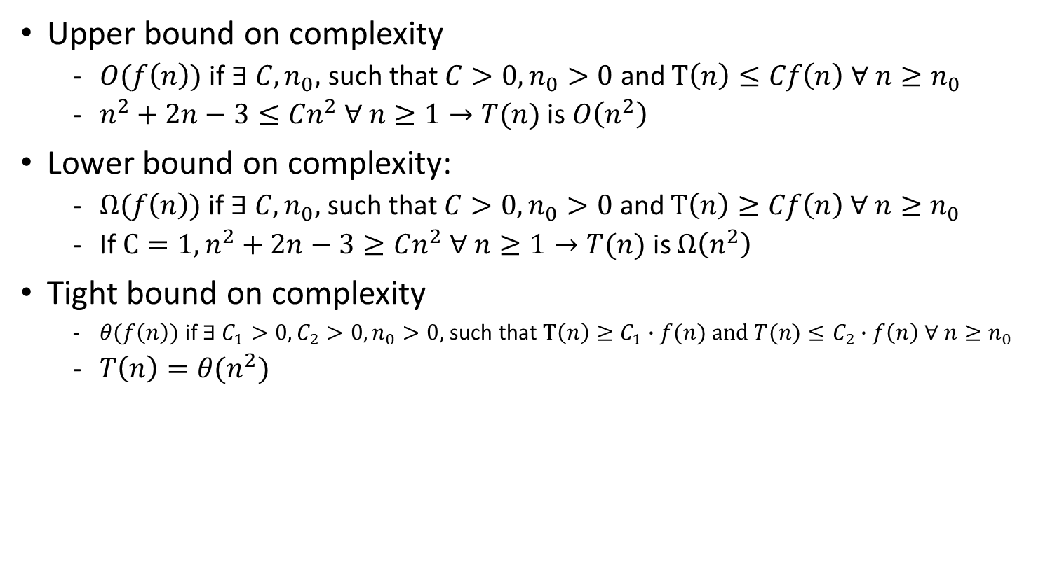
$$T\left(n\right)=n^{2}+2n−3$$
Upper bound on complexity
$O(f\left(n\right))$ if $∃ C, n_{0},$ such that $C>0,n_{0}>0$ and $T\left(n\right)≤Cf\left(n\right) ∀ n≥n_{0}$
$n^{2}+2n−3≤Cn^{2} ∀ n≥1→T(n)$ is $O\left(n^{2}\right)$
Lower bound on complexity:
$Ω(f\left(n\right))$ if $∃ C, n_{0},$ such that $C>0,n_{0}>0$ and $T\left(n\right)≥Cf\left(n\right) ∀ n≥n_{0}$
If $C=1, n^{2}+2n−3≥Cn^{2} ∀ n≥1→T(n)$ is $Ω\left(n^{2}\right)$
Tight bound on complexity
$θ(f\left(n\right))$ if $∃ C_{1}>0,C_{2}>0, n_{0}>0,$ such that $T\left(n\right)≥C_{1}∙f(n) and {T(n)≤C}_{2}∙f\left(n\right) ∀ n≥n_{0}$
$T\left(n\right)=θ(n^{2})$
Do not worry! This material is optional

Slide 18
Performance of Python Data Structures
We will study Big-O performance for common python operations on lists and dictionaries (hashes)
It is important for you to understand the efficiency of these Python data structures because they are the building blocks we will use as we implement other data structures in the remainder of the course

Slide 19
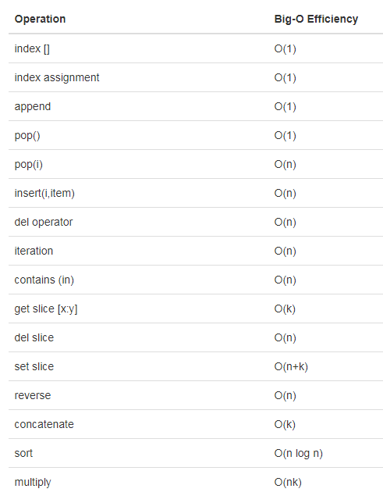
Lists
The designers of Python had many choices to make when they implemented the list data structure.
Each of these choices could have an impact on how fast list operations perform.
To help them make the right choices they looked at the ways that people would most commonly use the list data structure and they optimized their implementation of a list so that the most common operations were very fast.
Of course they also tried to make the less common operations fast, but when a tradeoff had to be made the performance of a less common operation was often sacrificed in favor of the more common operation.

Slide 20
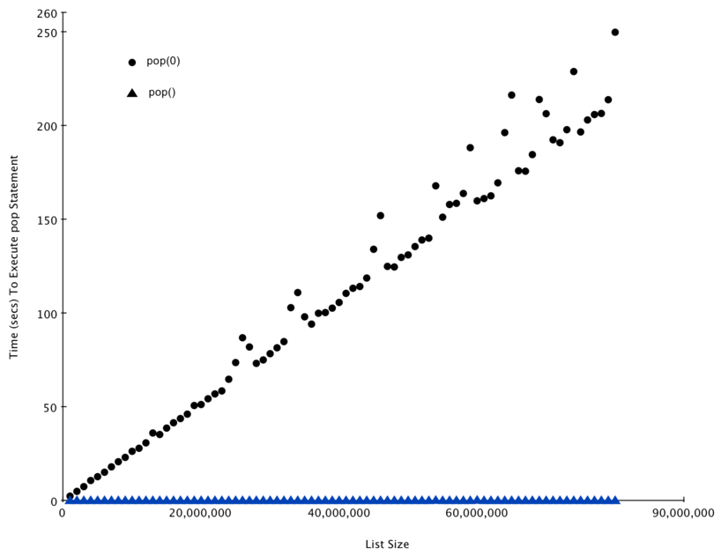
Test the performance of the pop operation on a list of known size

Slide 21
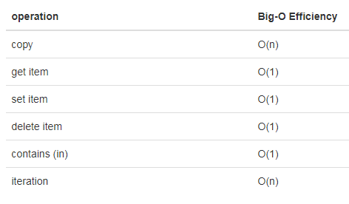
Dictionaries (hashes)
The second major Python data structure is the dictionary.
Dictionaries differ from lists in that you can access items in a dictionary by a key rather than a position.
The thing that is most important to notice right now is that the get item and set item operations on a dictionary are constant time O(1).
Another important dictionary operation is the contains operation.
Checking to see whether a key is in the dictionary or not is also O(1).

Slide 22
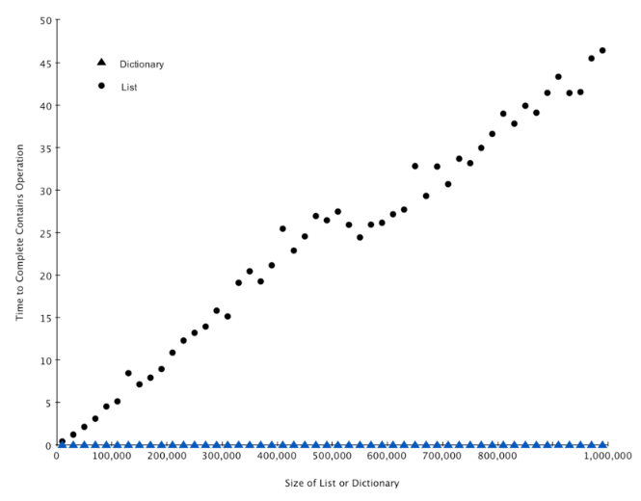
Test the performance of the contains operation on a list and a dictionary

Slide 23
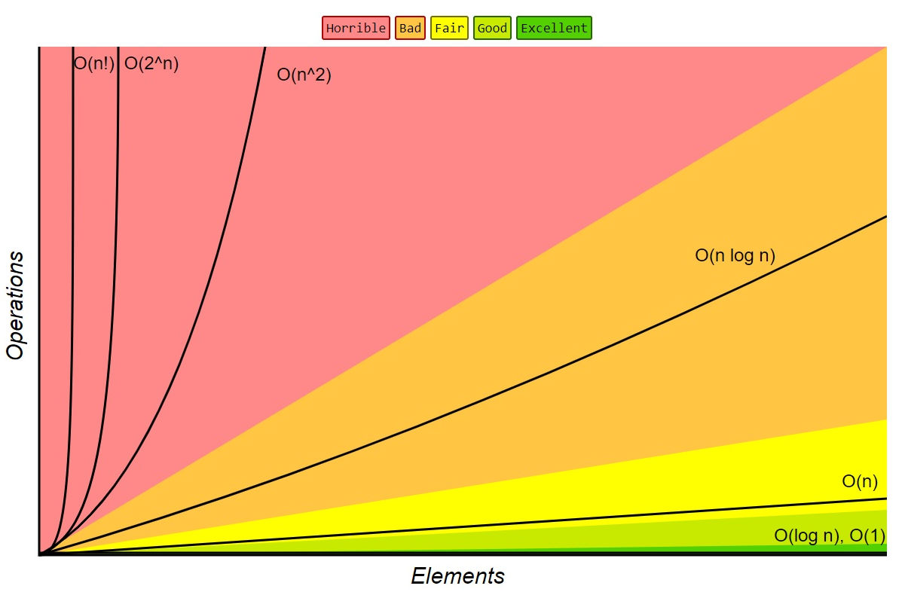
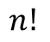
Summary
Algorithm analysis is an implementation-independent way of measuring an algorithm performance.
Big-O notation allows algorithms to be classified by their dominant computational resources consuming process with respect to the size of the problem.
$$n!$$
Factorial

Slide 24
References
Problem-solving with algorithms and data structures

